Slide 1

MIPS Single-Cycle Implementation
Alexander Titov
22 November 2014

Slide 2
Layers of Abstraction in Computes Science (CS)
Application
Algorithms
Programming Language
Operating System
Instruction Set Architecture
Topic of
this lecture
Microarchitecture
Gates/Register-Transfer Level (RTL)
Circuits
Physics

Slide 3
Review of the Previous Lecture
Assembly language is machine language expressed in symbolic form, using decimal and naming
Register-to-register arithmetic instructions are R-type
Load, store, branch, & immediate instructions are I-type
The jump instruction uses the J-type instruction format
Moving data to/from memory uses imm($rs) for the effective address, ea = imm + $rs, to reference Mem[ea]
Branch and Jump destinations refer to words (instructions) not bytes
Branch offsets are relative to PC+4
op
rs
rt
rd
shamt
funct
6 bits
5 bits
5 bits
5 bits
5 bits
6 bits
op
rs
rt
imm
6 bits
5 bits
5 bits
16 bits
op
offset in words
6 bits
26 bits

Slide 4
Single-Cycle Implementation Of MIPS
Any ISA can be implemented in many different ways
The simplest one is single-cycle implementation:
All operations are executed strongly sequentially
Execution of an instruction is not started until the previous one is completely executed (no overlapping)
All instructions take the same amount of time – a single cycle
For simplicity, only the following instructions will be considered
Arithmetic | add, sub, or, and, slt
Data transfer | lw, sw
Control | beq

Slide 5
Computer as a State Machine
A computer is just a big fancy state machine
Registers, memory, hard disks and other storage form the state
The processor keeps reading and updating the state, according to the instructions in some program
CPU
State

Slide 6
Refresher: Instruction Execution Cycle
Fetch Instruction by PC
Download instruction from the memory using value stored in the program counter (PC) register as an address.
Read registers
Read values of registers which are pointed by the instruction as their source operands.
Process Calculations
Execute an action encoded in the instruction (e.g. addition, subtraction, address calculation, etc.).
Read/Write
Memory
Write the result of the calculation into the memory or read the value using the address calculated on the previous step.
Write registers
Write the result of the calculation or the value read on the previous step into the memory.
Update PC
Update the program counter to the next instruction:
PC = PC + InstructionLength
Or it is a taken branch then:
PC = PC + InstructionLength + BranchOffset

Slide 7
Instruction Fetch
The CPU is always in an infinite loop, fetching instructions from memory and executing them
The program counter or PC register holds the address of the current instruction
MIPS instructions are each four bytes long, so the PC should be incremented by four to read the next instruction in sequence
Add
4
PC
Read
address
Instruction [31-0]
Memory

Slide 8
Executing R-Type Arithmetic Instructions
Read an instruction from the instruction memory by the address in PC
The source registers, specified by instruction fields rs and rt, should be read from the register file
The ALU performs the desired operation
Its result is stored in the destination register, which is specified by field rd of the instruction word
RegWrite
Read
address
Instruction [31-0]
I [25-21]
Read
register 1
Read
data 1
ALU
Memory
I [20-16]
Read
register 2
Read
data 2
Result
I [15-11]
Write
register
Write
data
ALUop
Registers
op
rs
rt
rd
shamt
funct
31
26
25
21
20
16
15
11
10
6
5
0

Slide 9
Executing I-type Arithmetic Instructions
Read an instruction from the instruction memory by the address in PC
The 1st source register, specified by instruction field rs, should be read from the register file
The signed immediate is extended (from 16 to 32 bits) and directly transferred to ALU
The ALU performs the desired operation
Its result is stored in the destination register, which is specified by field rt of the instruction word
RegWrite
RegWrite
I [25-21]
Read
address
I [25-21]
Read
address
Instruction [31-0]
Instruction [31-0]
Read
register 1
Read
register 1
Read
data 1
Read
data 1
ALU
ALU
I [20-16]
I [20-16]
Read
register 2
Memory
Read
register 2
Memory
Result
Read
data 2
Result
Read
data 2
0
I [15-11]
0
Write
register
m
u
x
Write
register
m
u
x
Write
register
I [15-11]
1
ALUop
1
Write
data
ALUop
Write
data
Registers
RegDst
Registers
ALUSrc
I [15-0]
Sign extend
I-type
op
rs
rt
imm
R-type
op
rs
rt
rd
shamt
funct
31
26
25
21
20
16
15
11
10
6
5
0

Slide 10
Executing I-type Store Instructions
Read an instruction from the instruction memory by the address in PC
The 1st source register (base address), instruction field rs, is read from the register file
The 2nd source register (written value), instruction filed rt, is read from the register file
The signed displacement is extended (from 16 to 32 bits) and directly transferred to ALU
The ALU calculates the effective address
The value is written into the memory by the effective address
RegWrite
MemWrite
Read
address
Instruction [31-0]
I [25-21]
Read
register 1
Read
data 1
ALU
Memory
I [20-16]
Read
register 2
Write
address
Read
data 2
Result
0
0
Write
register
m
u
x
Write
data
I [15-11]
m
u
x
1
Memory
1
Write
data
ALUop
RegDst
Registers
ALUSrc
I [15-0]
Sign extend
I-type
op
rs
rt
displ
R-type
op
rs
rt
rd
shamt
funct
31
26
25
21
20
16
15
11
10
6
5
0

Slide 11
Executing I-type Load Instructions
Read an instruction from the instruction memory by the address in PC
The 1st source register (base address), instruction field rs, is read from the register file
The signed displacement is extended (from 16 to 32 bits) and directly transferred to ALU
The ALU calculates the effective address
The value is read from the memory by the effective address
The result is written in the destination register specified by field rt
RegWrite
MemToReg
RegWrite
MemWrite
MemWrite
I [25-21]
Read
address
I [25-21]
Read
address
Instruction [31-0]
Instruction [31-0]
Read
register 1
Read
register 1
Read
data 1
Read
data 1
Read
address
Read
data
ALU
ALU
1
I [20-16]
m
u
x
I [20-16]
Read
register 2
Read
register 2
Write
address
Memory
Write
address
Memory
Result
Read
data 2
Result
0
Read
data 2
0
0
m
u
x
0
m
u
x
0
Write
data
Write
register
Write
data
Write
register
Memory
m
u
x
Memory
I [15-11]
m
u
x
I [15-11]
1
1
ALUop
1
ALUop
1
Write
data
Write
data
Registers
Registers
ALUSrc
RegDst
ALUSrc
RegDst
I [15-0]
I [15-0]
Sign extend
Sign extend
I-type
op
rs
rt
displ
R-type
op
rs
rt
rd
shamt
funct
31
26
25
21
20
16
15
11
10
6
5
0

Slide 12
Executing I-type Branch Instructions (1)
Read an instruction from the instruction memory by the address in PC
The source registers, specified by fields rs and rt, are be read from the register file
The signed offset is extended (from 16 to 32 bits) and shifted left by 2 (converted from words to bytes)
The address of the instruction after the branch is calculated (= PC + 4)
The target address of the branch is calculated as ((PC + 4) + (offset << 2))
The ALU compares the source operands (does subtraction) and generate the condition code (==, >, <, etc.)
The PC is update by the address of the instruction after the branch or by the target address depending on the branch opcode and the condition code
depends on the branch opcode
address of the next instruction
beq $t1, $t2, -0x0040
PC =
((Reg[$t1] – Reg[$t2]) == 0)
? ((PC + 4) + (-0x0040 << 2))
: (PC + 4)
condition
target address

Slide 13
Executing I-type Branch Instructions (2)
The branch may or may not be taken, depending on the ALU’s Condition Code output (Zero here)
4
0
Add
m
u
x
PC
Add
1
<< 2
PCSrc
RegWrite
MemWrite
MemToReg
Read
address
Instruction [31-0]
I [25-21]
Read
register 1
Read
data 1
Read
address
Read
data
ALU
1
I [20-16]
Zero
m
u
x
Memory
Read
register 2
Result
Write
address
0
Read
data 2
0
0
Write
register
m
u
x
Write
data
I [15-11]
m
u
x
1
Memory
1
Write
data
ALUop
RegDst
Registers
ALUSrc
I [15-0]
Sign extend
I-type
op
rs
rt
offset
R-type
op
rs
rt
rd
shamt
funct
31
26
25
21
20
16
15
11
10
6
5
0

Slide 14
The Final Single-Cycle Data Path
4
0
Add
m
u
x
PC
Add
1
<< 2
PCSrc
RegWrite
MemWrite
MemToReg
Read
address
Instruction [31-0]
I [25-21]
Read
register 1
Read
data 1
Read
address
Read
data
ALU
1
I [20-16]
Zero
m
u
x
Memory
Read
register 2
Result
Write
address
0
Read
data 2
0
0
Write
register
m
u
x
Write
data
I [15-11]
m
u
x
1
Memory
1
Write
data
ALUop
RegDst
Registers
ALUSrc
I [15-0]
Sign extend

Slide 15
Control Unit
The control unit is responsible for setting all the control signals so that each instruction is executed properly
The control unit needs 12 bits of an instruction
Six bits make up the instruction opcode
Six bits come from the instruction func field
It also needs the Conditional Code output of the ALU
The control unit generates 7 of output, corresponding to the signals mentioned on the data path
Read
address
I [31-26]
Control
RegWrite
Read
address
Instruction [31-0]
Instruction [31-0]
ALUSrc
Memory
RegDst
Memory
I [5-0]
ALUop
PCSrc
CondCode
MemWrite
MemToReg

Slide 16
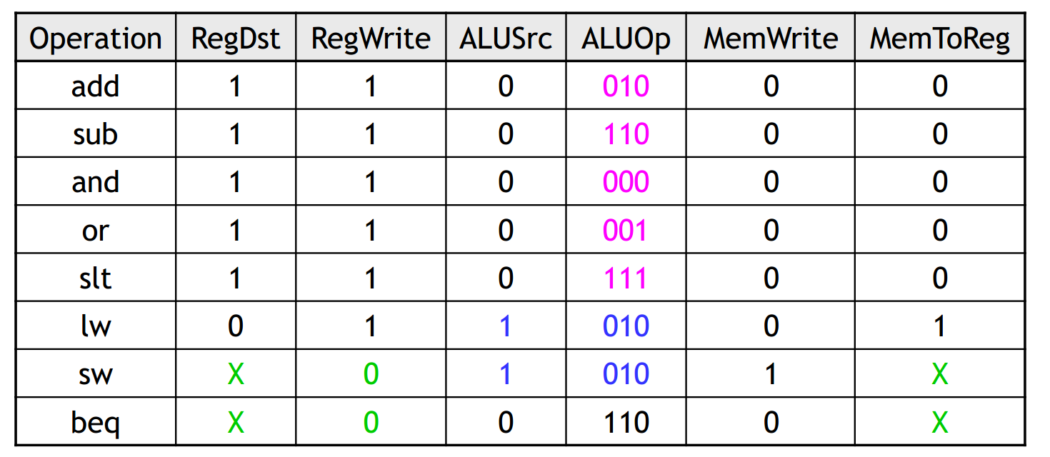
Control signal table
sw and beq are the only instructions that do not write any registers
lw and sw are the only instructions that use the constant field. They also depend on the ALU to compute the effective memory address
ALUOp for R-type instructions depends on the instructions’ func field
The PCSrc control signal (not listed in the table) should if instruction is branch and it is taken (the ALU’s conditional code is analysed)

Slide 17
Summary
A datapath contains all the functional units and connections necessary to implement an instruction set architecture.
For our single-cycle implementation, we use two-ported memory, register file, an ALU, some extra adders, and lots of multiplexers.
MIPS is a 32-bit machine, so most of the buses are 32-bits wide
The control unit tells the datapath what to do, based on the instruction that’s currently being executed
The discussed processor has seven control signals that regulate the datapath
The control signals can be generated by a combinational circuit with the instruction’s opcode and func fields as the input

Slide 18
Acknowledgements
These slides contain material developed and copyright by:
Luis Ceze (UW), CS378, L1, L6 and L8

Slide 19
Thank You Q/A

